Slide 1
Density Based Traffic Light Controller Using Arduino
Nafia Nowrin Shitul
2014-1-60-052
Mustafa Wasif Allvi
2015-1-60-022
Mohiuddin Shoikot
2015-1-60-150

Slide 2
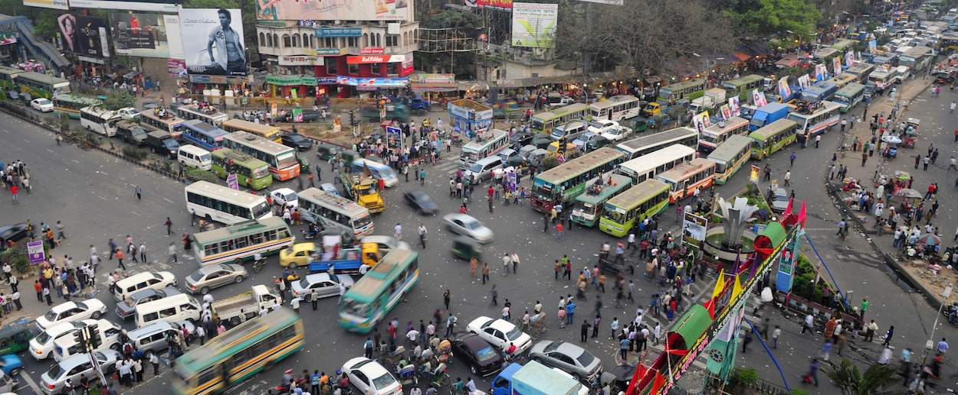
Introduction
Designing a traffic signal to control the traffic lights based on the density of the vehicles and pedestrian to reduce traffic congestion

Slide 3
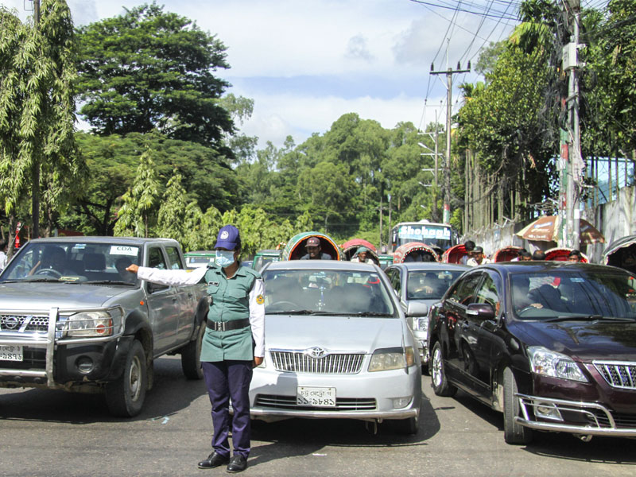
Project Aim
Designing a smart traffic control system
To develop coding and to implement it in hardware of density based traffic light control system using Arduino.
Control the crowd where density is very high

Slide 4
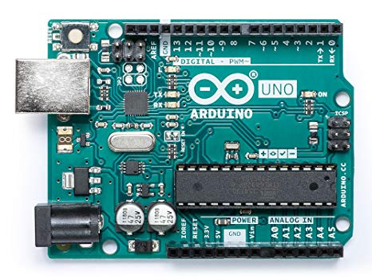
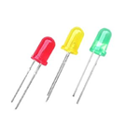
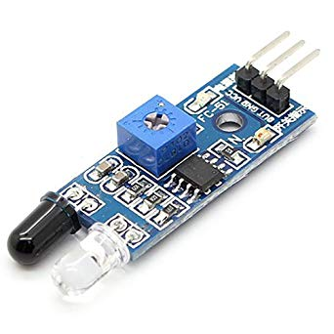
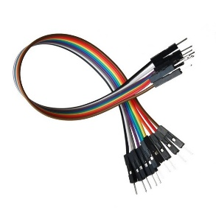
Component Used
Arduino Uno
LED
IR Sensor
Jumper Wire

Slide 5
Circuit Operation
NORMAL MODE In this mode of operation green , yellow and red lights change after a fixed time period like a typical traffic signal. Here, light from IR transmitter LED reach IR receiver without any interruption.
DENSITY MODE When amount of cars increases, light of IR transmitter intersect by cars to reach the receiver. Where density is high the system will generate the green signal to clear the traffic

Slide 6
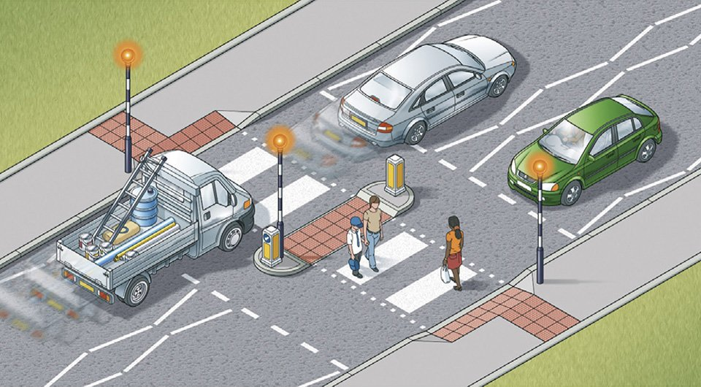
Real life view

Slide 7
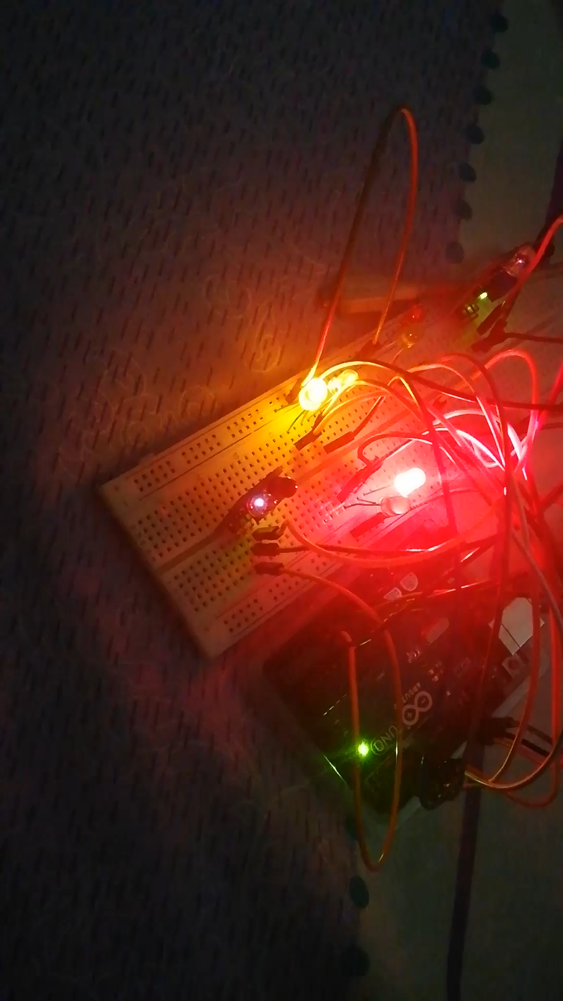
Project Video

Slide 8
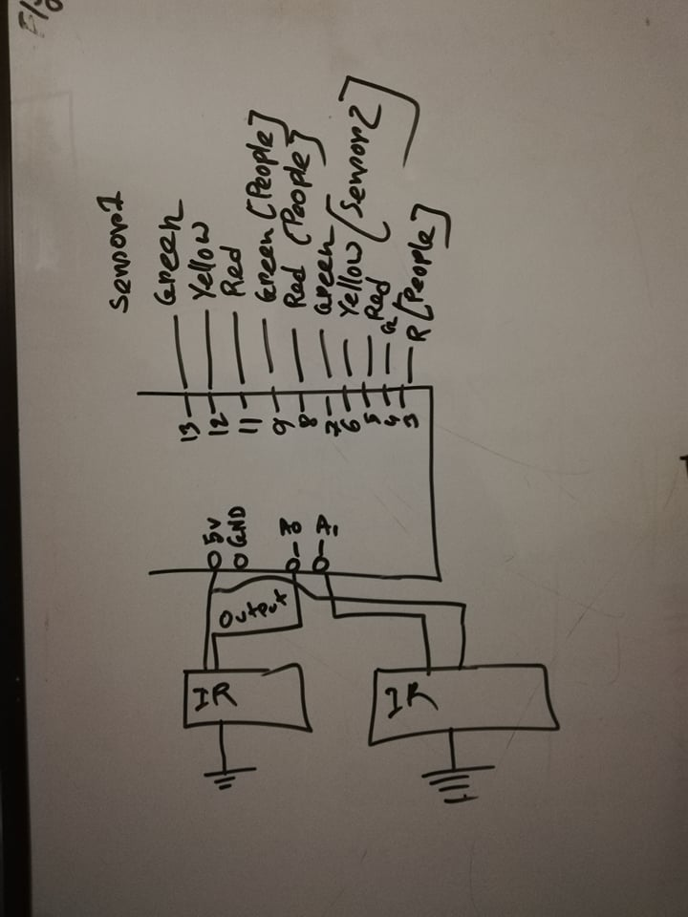
Circuit diagram

Slide 9

Future Work
We will implement this system for traffic controlling in a
4 lane junction
During the red signal a barricade will close the path for both pedestrian and vehicle
During the red signal if any driver try to move in red signal it will turn on an alarm to warn the driver

Slide 10
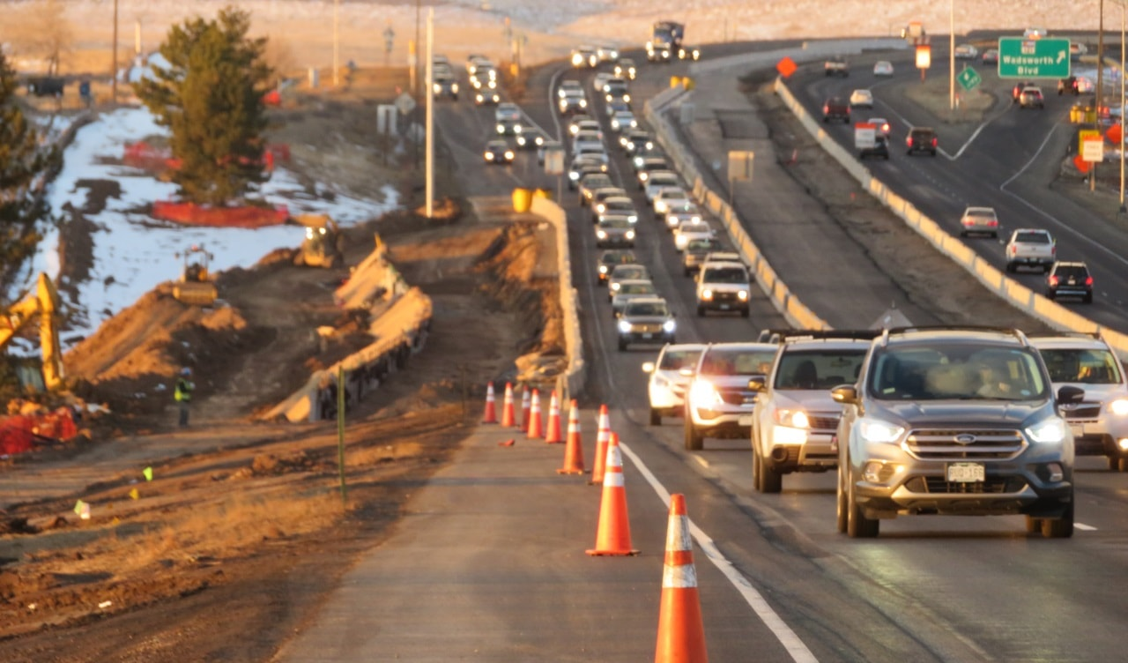
Conclusion
“Density Based Traffic Light Controller Using Arduino” is
appropriate enough to use commercially. It will help us to
build a time friendly & secure traffic system.

Slide 11


